Slide 1
Competitive Intelligence Matching Guidance

Slide 2
Matching Definition
The purpose of this tool is to identify if two products are or are not a match. Two products are a match if they’re exactly the same. That means they:
Are the same item
Are the same size
Some items come in many sizes, like rugs or beds. They must be the same size to be a match, like two queen beds or two 3’ x 5’ rugs.
Have the same color or finish
Other items come in different colors, like a chair that comes in both red and blue. The two items must be the same color to be a match: you can match the red chair to the red chair or the blue chair to the blue chair, but you cannot match the red chair to the blue chair.
Are made by the same manufacturer
Sometimes Wayfair or the competitor will change the manufacturer name, so be careful! If the manufacturer names are different but all the other information looks good, the items can still be matched.
Are sold in the same quantity
Some items, like cups or bar stools, can be sold in different quantities like a set of 4 mugs or a set of 2 barstools. For two items to be a match, they must be sold in the same quantity. You can match a set of 4 mugs to a set of 4 mugs, but you cannot match 1 mug to a set of 4 mugs even if they’re the same item.
If a Wayfair item is sold in sets, it will say so in the Quantity menu on the product page. You can also check the specifications for set quantity.
If an Amazon item is sold in sets, it will say so in the product name.

Slide 3
Review: What is a match?

Slide 4
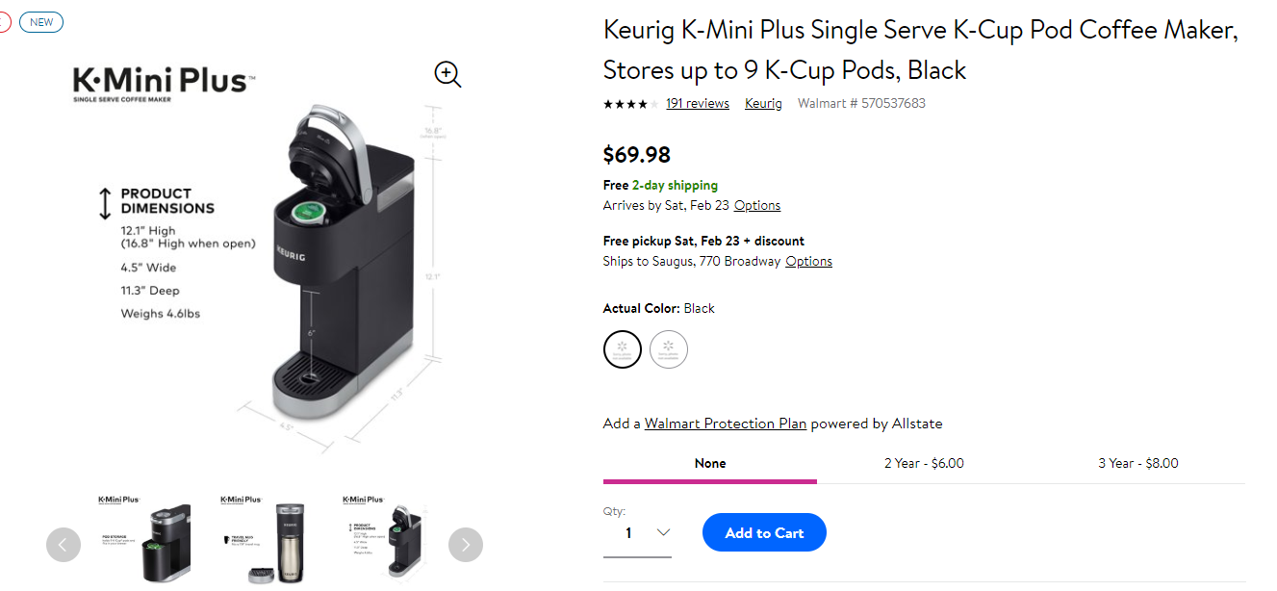
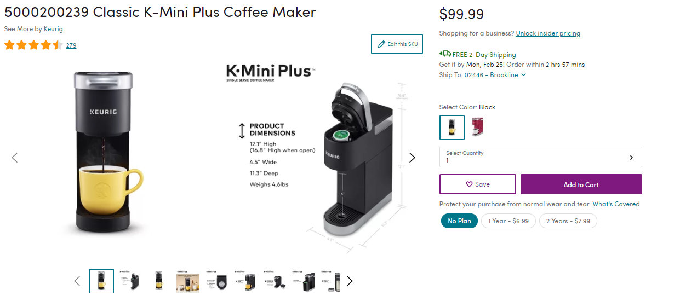
What is a match?
Two products are a match if they’re exactly the same. That means they:
Are the same item
Are the same size
Some items come in many sizes, like rugs or beds. They must be the same size to be a match, like two queen beds or two 3’ x 5’ rugs.
Have the same color or finish
Other items come in different colors, like a chair that comes in both red and blue. The two items must be the same color to be a match: you can match the red chair to the red chair or the blue chair to the blue chair, but you cannot match the red chair to the blue chair.
Are made by the same manufacturer
Sometimes Wayfair or the competitor will change the manufacturer name, so be careful! If the manufacturer names are different but all the other information looks good, the items can still be matched.
Are sold in the same quantity
Some items, like cups or barstools, can be sold in different quantities like a set of 4 mugs or a set of 2 barstools. For two items to be a match, they must be sold in the same quantity. You can match a set of 4 mugs to a set of 4 mugs, but you cannot match 1 mug to a set of 4 mugs even if they’re the same item.
If a Wayfair item is sold in sets, it will say so in the Quantity menu on the product page. You can also check the specifications for set quantity.
If an Amazon item is sold in sets, it will say so in the product name.

Slide 5
Review: What isn’t a match?

Slide 6
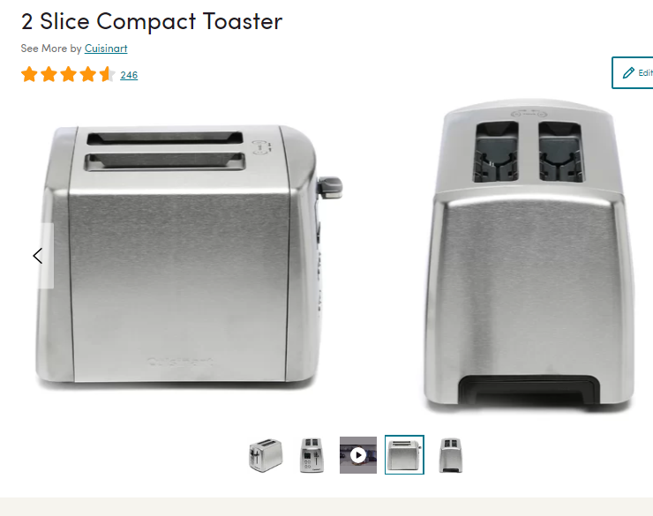
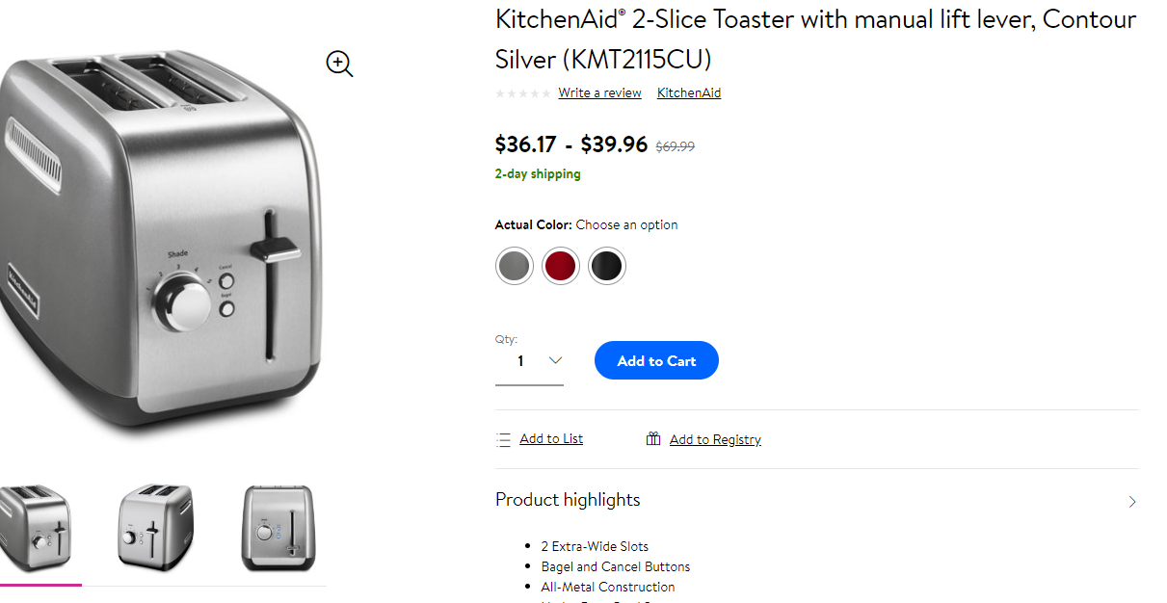
What isn’t a match?
Any items that aren’t exactly the same are not a match. This can be because they:
Are completely different kinds of items, like a couch and a shower curtain.
Are similar items, but made by different manufacturers.
Example: These are both silver, two slice toasters with levers, but one is made by Cuisnart and one is made by Kitchenaid

Slide 7
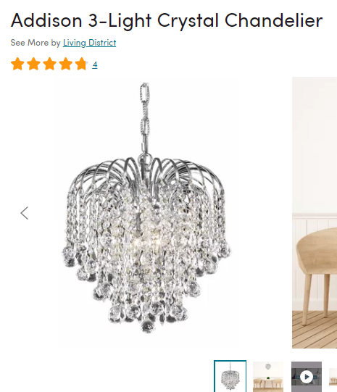
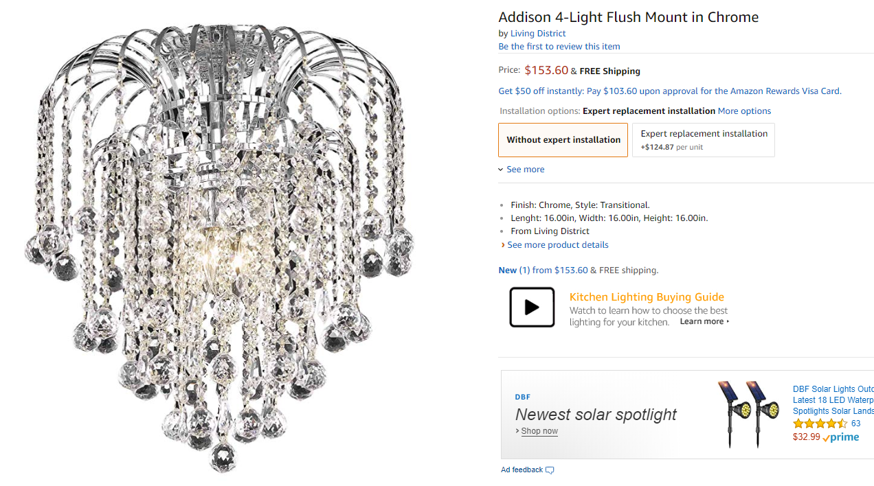
What isn’t a match?
Any items that aren’t exactly the same are not a match. This can be because they:
Are different colors of the same item, like a placemat in brown and a placemat in green.
Are different sizes of the same item, like a king vs. a queen bed or a 5” x 7” picture frame vs. an 18” x 24” frame.
Are similar items made by the same manufacturer, but have a key difference: a 5-light chandelier and a 6-light chandelier would not be a match.
Example: The following are both crystal chandeliers in Addison design made by Living District, but one has 3 lights and one has 4

Slide 8
Matching Examples

Slide 9
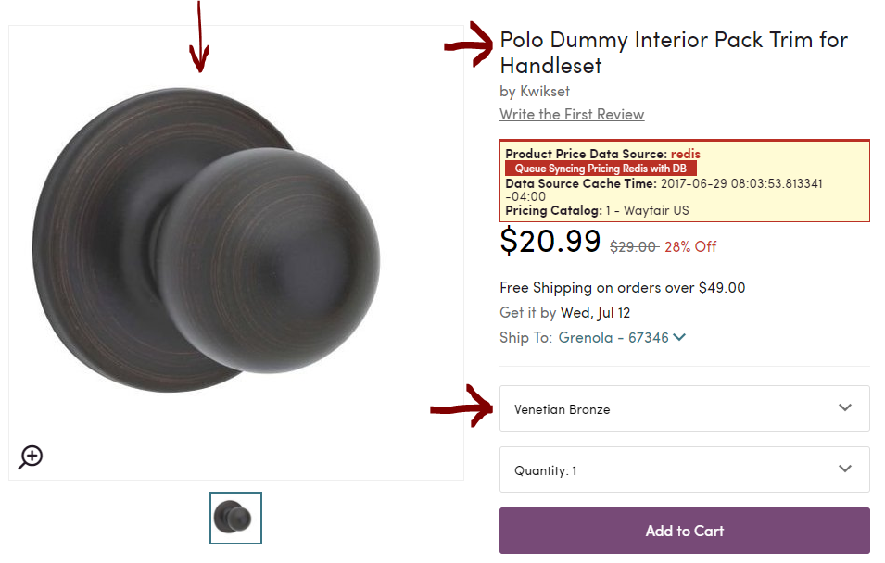
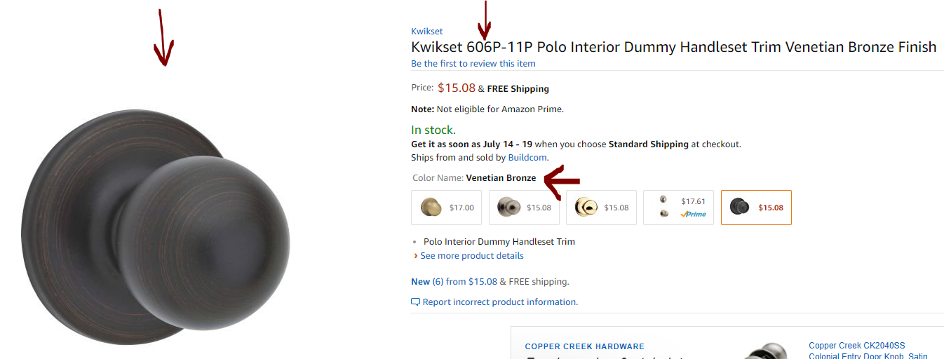
Example 1
Wayfair page: Competitor page:
We can tell these items are an exact match because they both have:
The same manufacturer, Kwikset
The same model number, 606P-11P
The same finish option, Venetian Bronze
The same image
Similar product names: Interior Dummy Handleset Trim compared to Interior Pack Trim for Handleset
This is an Exact Match

Slide 10

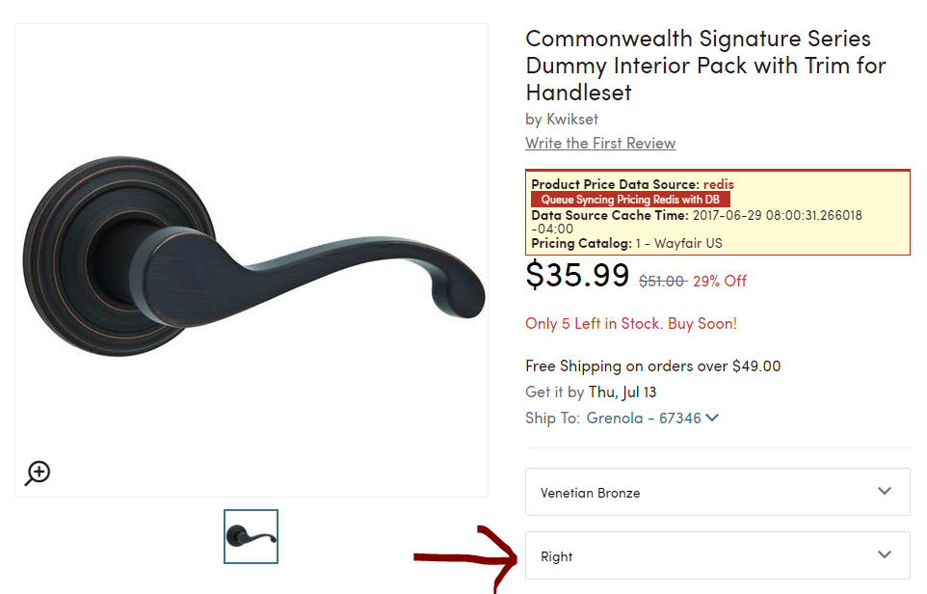
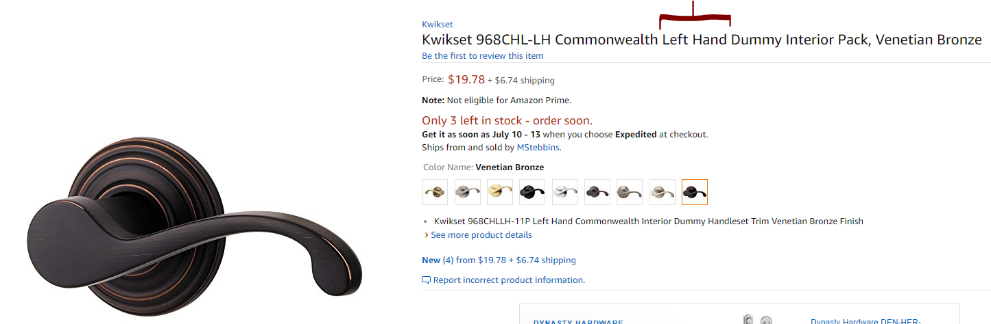
Example 2
Wayfair page: Competitor page:
We can see that these items have have:
The same manufacturer, Kwikset
The same model number, 606P-11P
The same finish option, Venetian Bronze
The same image
Similar product names: “Interior Dummy Handleset” Trim compared to “Interior Pack Trim for Handleset”
However, they don’t have the same option; the Wayfair item is a right-oriented handle and the Amazon item is a left-oriented handle
This is not an Exact Match (different options)

Slide 11
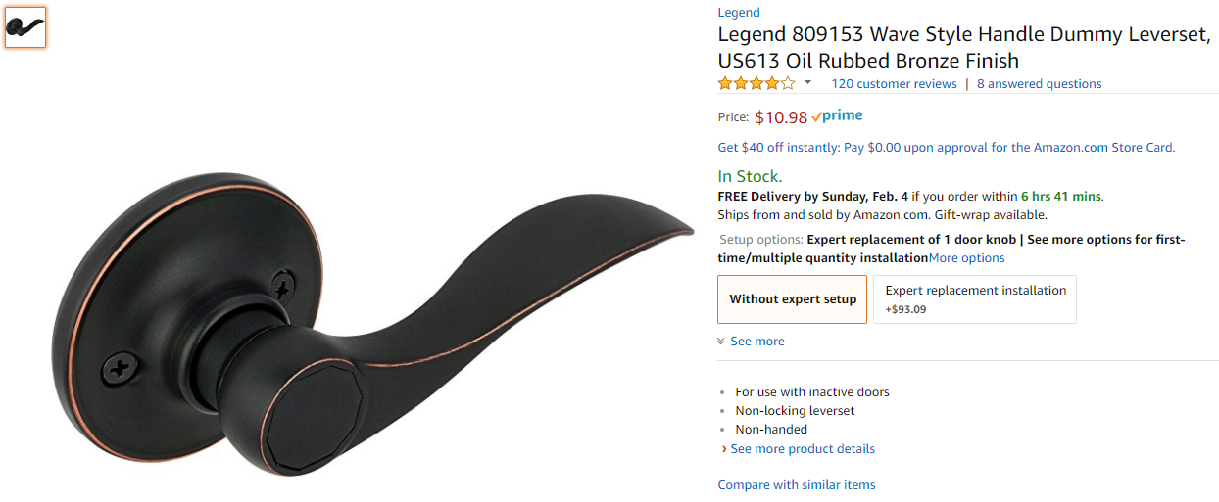
Example 3
Wayfair page: Competitor page:
We can tell these items are not a match because they have:
different manufacturers, Kwikset vs. Legend
Different model number, 606P-11P vs. 809153
Different finish option, Venetian Bronze vs. Oil rubbed Bronze
Different images
Similar product names: “Interior Pack Trim for Handleset” vs. “Handle Dummy Leverset”
Different option configurations; the Wayfair item is a right-oriented handle and the Amazon item is non-handed
This is not an exact match

Slide 12
Interactive Practice Examples

Slide 13
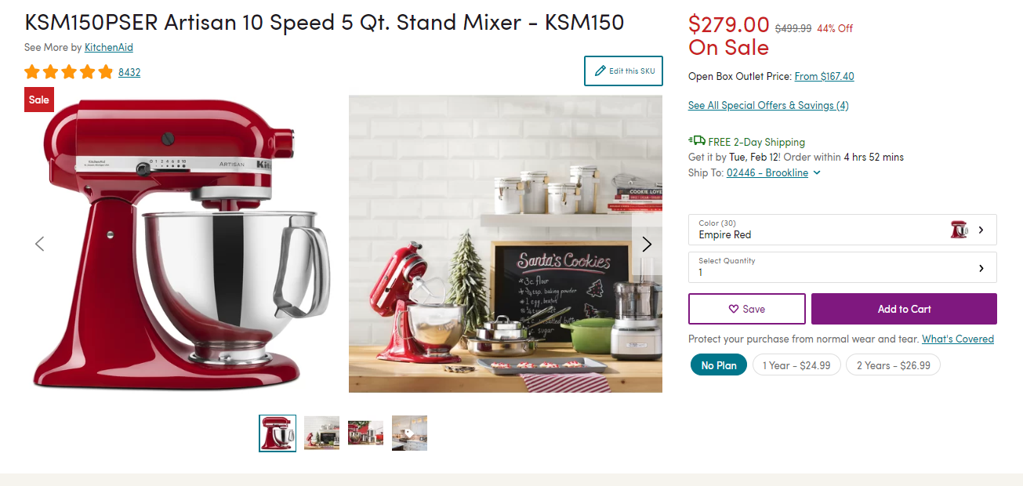
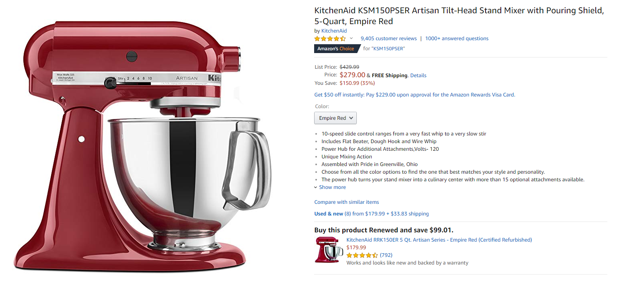
Interactive Practice Example 1
Wayfair page: Competitor page:
How would you evaluate these two products? What information on these pages help you make your decision?

Slide 14
Interactive Practice Example 1 Answer
Wayfair page: Competitor page:
From the above product pages we see the following
The products have the same part number: KSM150PSER
The products have the same manufacturer: KitchenAid
The products have the same size: 5 Qts
The products have the same color: Empire Red
The products have the same feature: 10 speed
We would conclude that these are an exact match

Slide 15
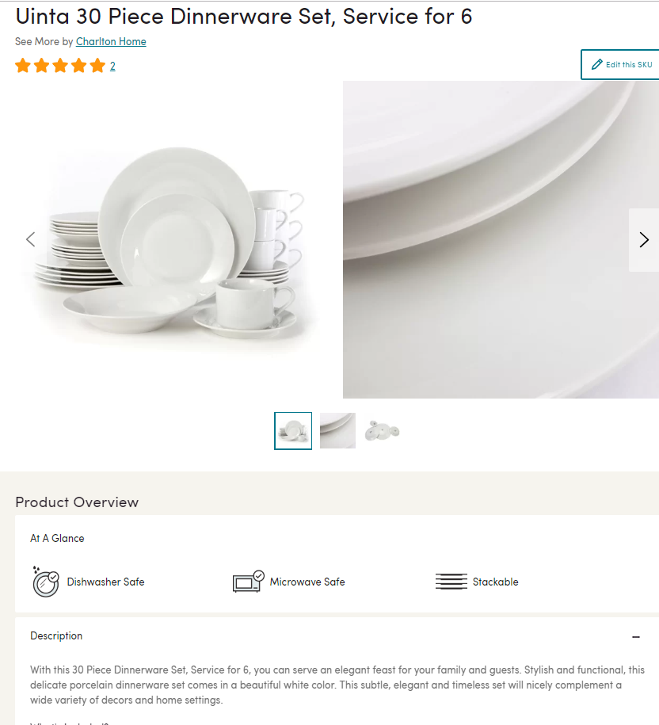
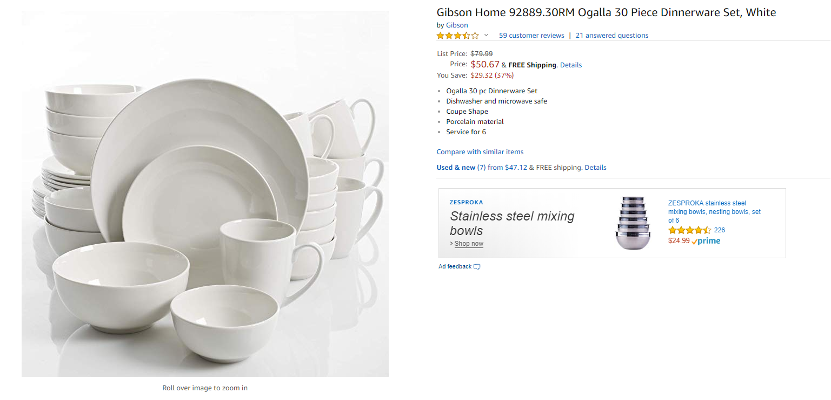
Interactive Practice Example 2
Wayfair page: Competitor page:
How would you evaluate these two products? What information on these pages help you make your decision?

Slide 16
Interactive Practice Example 2 Answer
Wayfair page: Competitor page:
From the above product pages we see the following
The products have the same color: white
The products have the same material: porcelain
The products have the same quantity: 30 pieces
The products have different manufacturers: Wayfair is by Charlton Home and competitor is Gibson
While the products look similar, you can see looking at the picture that these products are different-- the bowls, mugs, and plates are different sizes and shapes
We would conclude that these are NOT an exact match

Slide 17
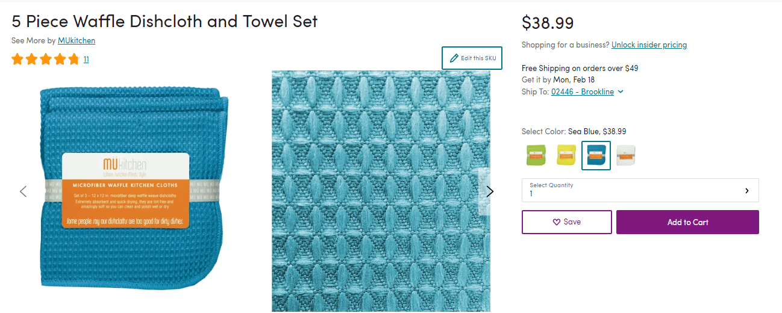
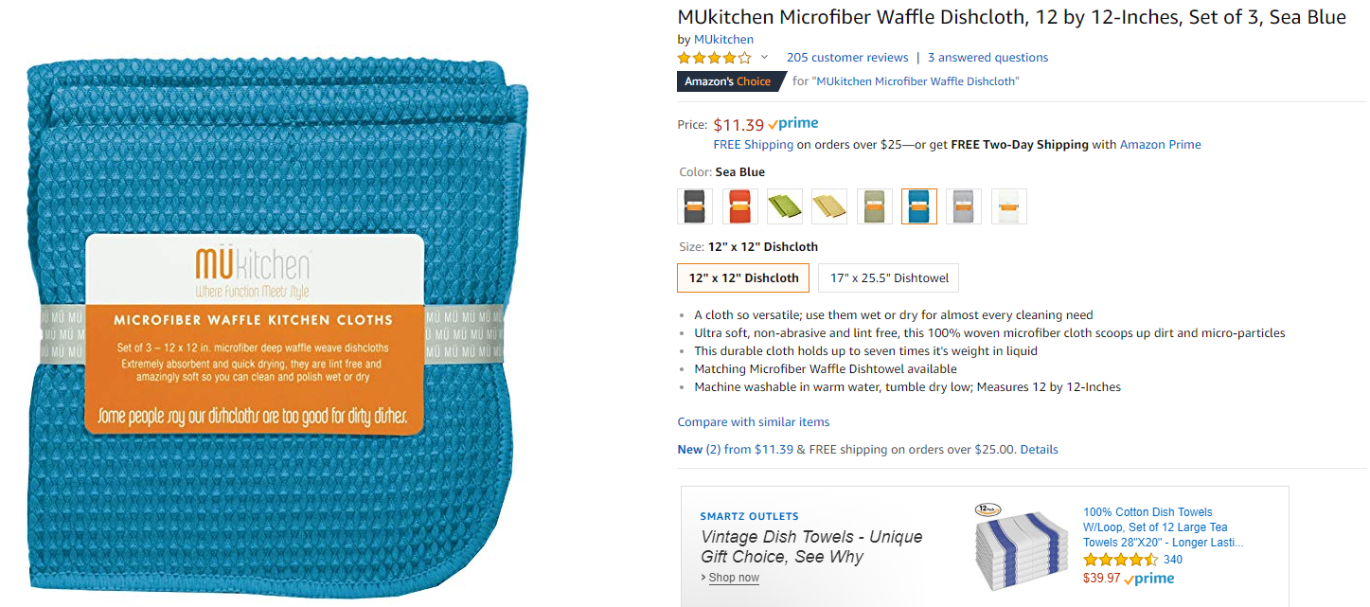
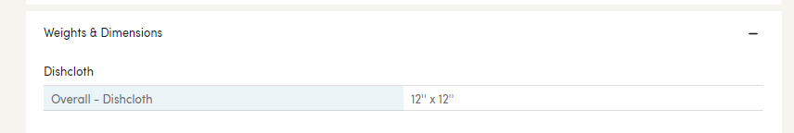
Interactive Practice Example 3
Wayfair page: Competitor page:
How would you evaluate these two products? What information on these pages help you make your decision?

Slide 18
Interactive Practice Example 3 Answer
Wayfair page: Competitor page:
From the above product pages we see the following
The products have the same manufacturer: MUKitchen
The products have the same size: 12” x 12”
The products have the same color: Sea Blue
The products have different quantities: Wayfair sells in quantity of 5 and competitor
sells in quantity of 3
We would conclude that these are not an exact match

Slide 19
Tips and Tricks

Slide 20
Matching Tool Tips
In order for two products to be a match, all of the product option information about them must match. For example, think of a rug that has options for color (green or brown) and size (3’ x 5’ or 5’ x 8’). In order for those items to match, all options must be the same.You can match the green 3’ x 5’ rug to the green 3’ x 5’ rug, and you can match the brown 5’ x 8’ rug to the brown 5’ x 8’ rug. You cannot match the green 3’ x 5’ rug to the brown 3’ x 5’ rug because those are different items.
Take your time to make good decisions-- we want to make sure we are making correct matching decisions rather than getting through decisions as fast as possible
Product colors may not be called the same thing on Wayfair as they are on a competitor site. If the colors are not named the same, but appear to look the same in images, these can be considered a match. For example, if the Wayfair product color is called “cherry”, but the competitor only has a color option called “red”, if the images of those colors look the same, we will consider them a match.
If two items have exactly the same photos, they’re most likely a match. If the photos are different but still show the same item, these are probably a match.
If two items have exactly the same name, they’re likely to be a match. However, some competitors change the names of items, so two products can be a match without having the same name

Slide 21
Matching Tool Tips
One of the areas you will examine is product dimensions. Please use the following tips and tricks when comparing Wayfair and competitor dimensions:
In the US, “ means inches, and ‘ means feet. For example, if width is listed as 13”, that means it is 13 inches. If the height is listed as 9’, that means 9 feet. And if the length is listed as 2’3”, that means 2 feet and 3 inches
Dimensions may not always match exactly on Wayfair and a competitor site. Dimensions within 1 inch of measurement should be considered a match because Wayfair or the competitor may be rounding. For example, if a competitor lists the width of their product as 12.3” and Wayfair lists it as 13”, we would consider these widths to match.
Dimensions may be listed differently on a competitor website than they are on Wayfair:
Decimal vs. Fractions: Product can be a match even if dimensions are listed as a decimal on a competitor and a fraction on Wayfair. For example, Wayfair may list that the length of a product is 8.8” and the competitor lists is as 8-13/16”. We will want to convert the length the competitor lists in fractions to a decimal so that we can compare it to the length listed on Wayfair. To do this, we have our 8 inches + 13/16 inches. 13/16 is 0.8, so we see that the competitor length equals 8.8”, and equals what is listed on Wayfair.
Dimensional Unit: Some competitors may enter their dimensions in millimeters (mm) or centimeters (cm) while we list them in inches. If this is the case, we will want to convert the measurements so that both Wayfair and the competitor are in the same unit before comparing. You can use the following websites to convert the units:
Millimeter to Inches
Centimeters to Inches
Inches vs. Feet and Inches combination: Wayfair may list dimensions in combined feet (‘) and inches (“), but competitor may list dimensions only in inches. Again, we will want to convert the measurements so that both Wayfair and the competitor are in the same format. Since 12 inches are in a foot, we can convert the dimensions so that both are listed only in inches, and compare if the measurements are a match. For example, if Wayfair lists that the length of a product is 1’6”, or 1 foot 6 inches, and the competitor lists the length as 18”, we can convert Wayfair’s length knowing that 1 foot is 12 inches, to see that both lengths are equal to 18 inches

